Slide 1
DIALOGUE NATIONAL SUR LES EAUX SOUTERRAINES - NATIONAL DIALOGUE ON GROUNDWATER
June 3, 2020 (1 – 2pm (ET))

Slide 2
SECOND CALL - OVERVIEW
Greetings and welcome intro by Réjean Couture – New manager for the Groundwater Geoscience Program (GGP) – 3 minutes
Quick Round-Table Presentation from all participants – 8 minutes
Presentations – Pacific North West (BC, YK, NWT) – 24 minutes
6 minutes: Collaboration on the shared waters of the Mackenzie River Basin (Isabelle de-Grandpré)
6 minutes: NWT’s groundwater program (Isabelle de-Grandpré)
6 minutes: BC’s groundwater program (Amy Sloma)
6 minutes: YT’s groundwater program (Brendan Mulligan)
Open discussion from all based on the comments received from participants – 25 minutes
Impacts of COVID-19 on all jurisdiction activities (e.g. Fieldwork)
Canada Water Agency - What is the place for groundwater?
New version of the National Hydro Network (NHN)
Data base contacts in provinces and territories – please follow up with Étienne Girard
Terms of Reference for the NDGW
Next meeting
September 2 - Presentations by Martin Stapinsky from the Ministère de l’environnement et de la lutte aux changements climatiques de la province de Québec and Daniel Paradis from the Geological Survey of Canada in Quebec City.

Slide 3
Collaboration on the shared waters of the Mackenzie River Basin

Slide 4
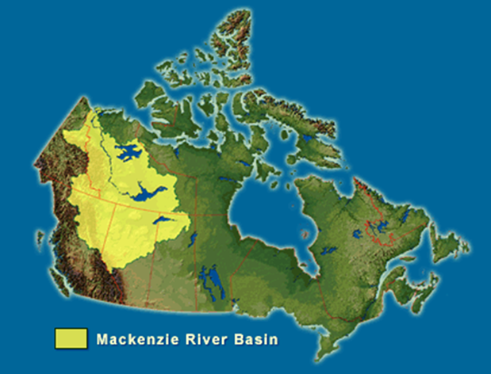
Mackenzie River Basin
20% of Canada’s land surface (1.8 million square kilometers)
1% of Canada’s population (400,000 people)
Crossing 5 jurisdictions (3 Provinces, 2 Territories)
Water flowing South to North into the Arctic Ocean

Slide 5
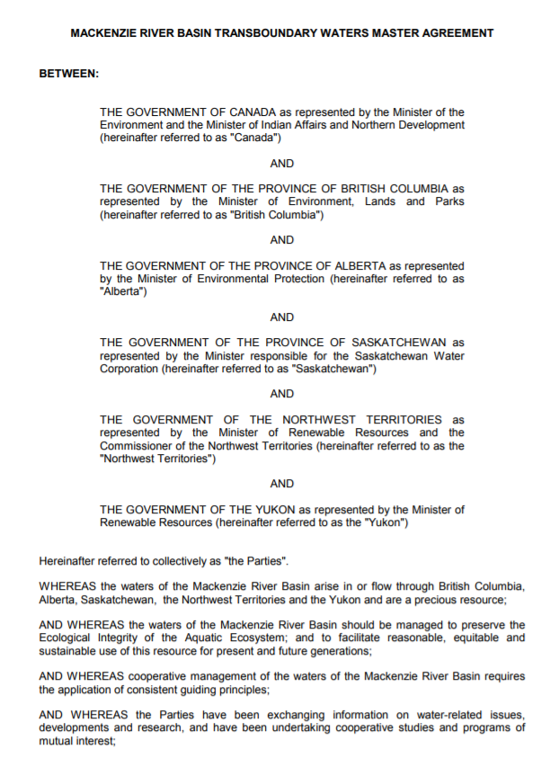
Mackenzie River Basin Transboundary Waters Master Agreement
The Mackenzie River Basin Transboundary Waters Master Agreement was signed in 1997 by :
Canada,
British Columbia
Alberta
Saskatchewan
Northwest Territories
Yukon
Notes:
The flow of surface and groundwater does not follow administrative boundaries, which often creates challenges in water governance.
Main purposes of the Mackenzie River Basin Transboundary Water Master Agreement:
To establish common principles for the cooperative management of the water resources in the Mackenzie River Basin in a manner consistent with the maintenance of the ecological integrity of the aquatic ecosystem.

Slide 6
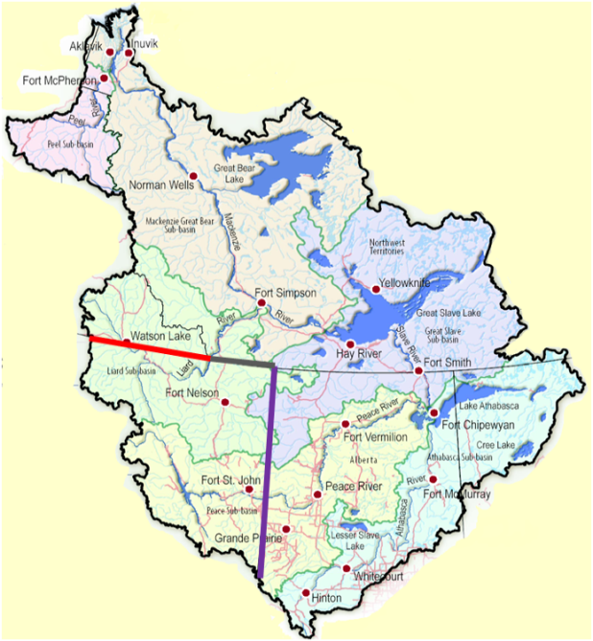
Bilateral Water Management Agreements (BWMA)
Yukon/NWT (Peel (2002) & Liard Rivers)
AB/NWT (Hay & Slave Rivers) (2015)
SK/NWT (Tazin River)
BC/Yukon (Liard River) (2017)
BC/NWT (Liard River) (2015)
BC/Alberta (Liard, Hay & Peace Rivers)
AB/SK (Lake Athabasca)
Notes:
The Master Agreement facilitates the establishment of Bilateral Water Management Agreements (BWMA) among the jurisdictions that are signatory to the Agreement.
For example:
- NWT and Yukon have a BWMA for the Peel watershed, and are in the process of developing a BWMA for the Liard watershed
- BC and NWT have BWMAs for the Liard watershed and the Petitot watershed
- BC and Yukon have a BWMA for the Liard watershed

Slide 7
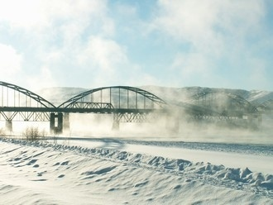
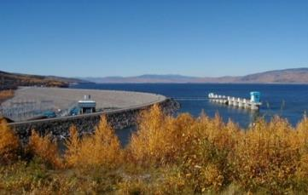
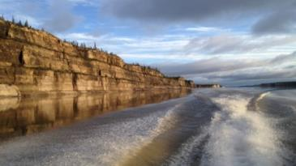
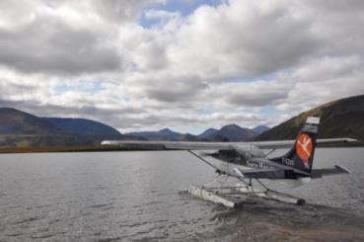
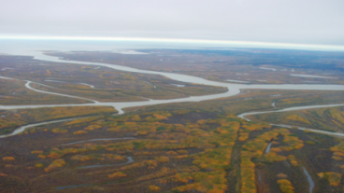
Principles of BWMAs
BWMAs commit pairs of jurisdictions to work together to:
Address specific water issues for transboundary basins/aquifers
Provide a framework for cooperative decision making and maintaining aquatic ecosystem health through surface water and groundwater quality, quantity and biology
Develop collaborative work plans
Improve knowledge of water resources and aquatic ecosystems
Establish a mechanism for information sharing, notification and consultation
Use a Risk Informed Management Approach (RIM)

Slide 8
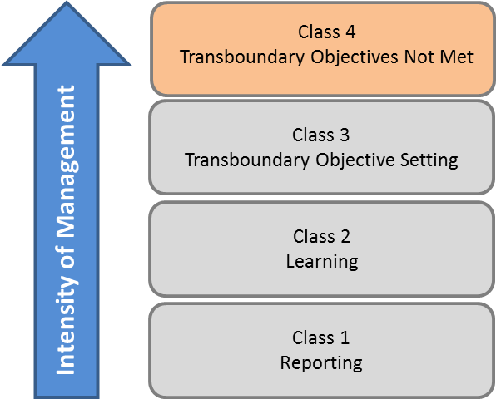
Risk Informed Management (RIM)
LOW Risk HIGH
Transboundary water bodies and aquifers are categorized based on risk.
Management actions increase in intensity with increased risk.
Class 1 – No action required
Class 2 – Learn, monitor and study
Class 3 – Continue to monitor and study, set objectives.
Class 4 – Actions required to return to meeting objectives ASAP so aquatic ecosystem health is maintained
Notes:
RIM: An approach for managing transboundary waters where risk is assessed and management actions are commensurate with identified risk.

Slide 9
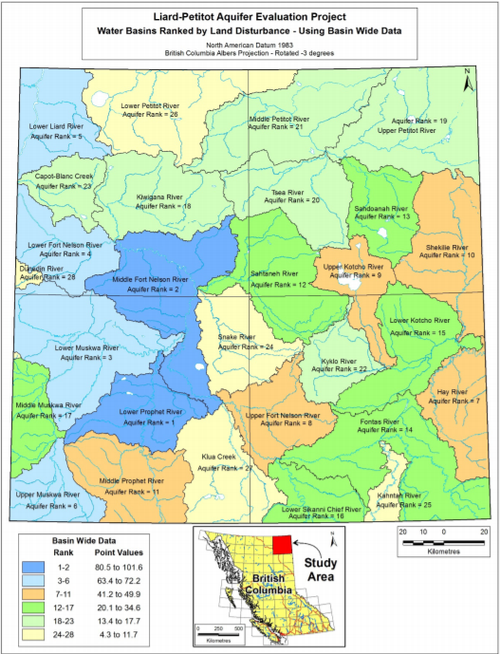
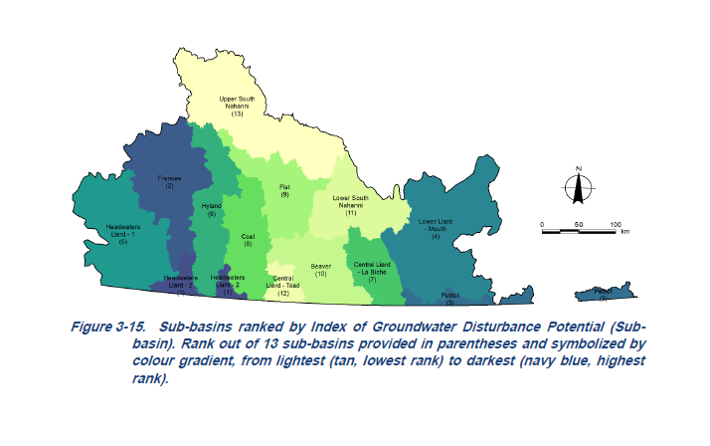
Collaborative Work in the Liard Basin
Notes:
Desktop-based assessment of aquifers and their vulnerabilities to different land use activities within the BC, Yukon and NWT portions of the Liard River basin based on compilation, synthesis and analysis of existing groundwater, geology and surficial deposits-related information.
- BC portion done by Quaternary Geosciences Inc and collaborators in 2018
- NWT and Yukon portion done by Palmer Environmental Consulting Group Inc., in association with Yellowknife-based Aurora Geosciences Ltd, work completed for June 15, 2020

Slide 10
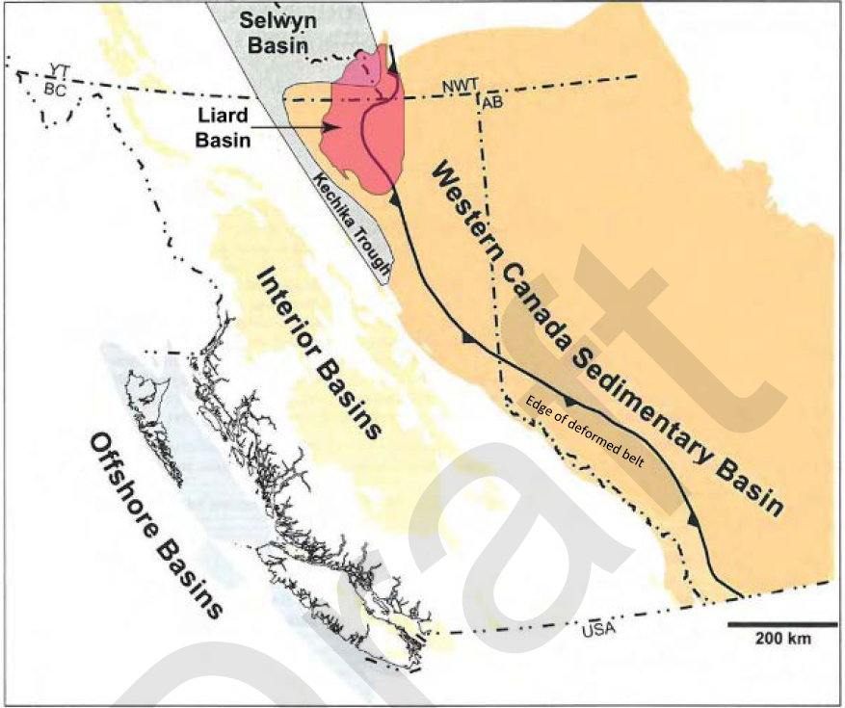
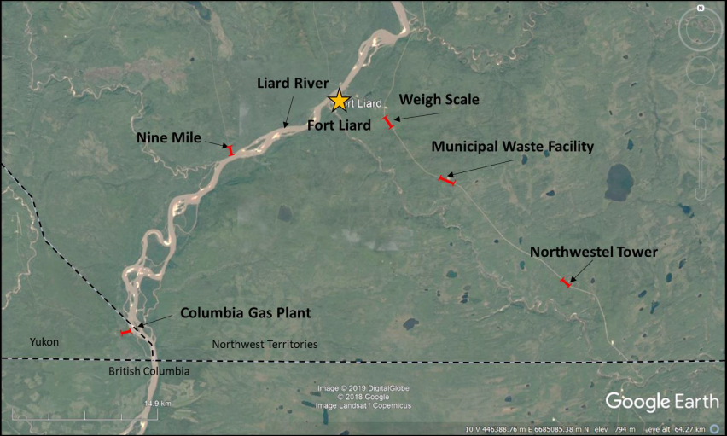
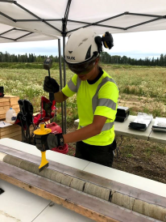
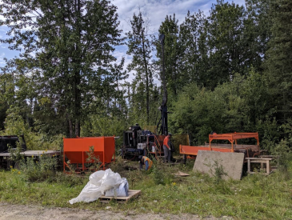
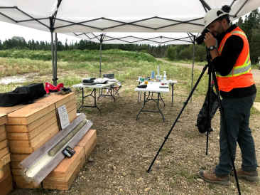
Collaborative Work in the Liard Basin
Notes:
Groundwater baseline characterization of the Liard Basin
The Liard Basin is a region of high oil and gas potential (conventional and unconventional)
The goal of the project is to get baseline information on fresh water aquifer prior to intensive development
- The idea for this project started in Yukon in 2016
- Funds were available in NWT, project started in NWT in collaboration with Beth Parker, University of Guelph
- If additional funding, project will extend to Yukon and BC

Slide 11
Groundwater Program, Northwest Territories
Isabelle de Grandpré, Government of Northwest Territories

Slide 12
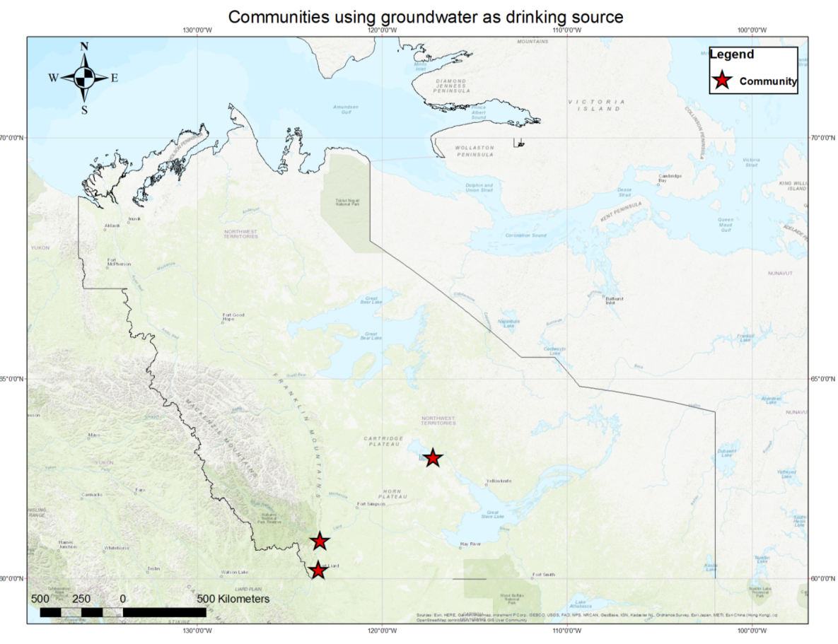
Notes:
NWT population about 40,000
The only groundwater use at the moment (groundwater withdrawal) is in 3 communities (Fort Liard, Nahanni Butte and Whati)
Total population relaying on groundwater: About 1050 (2.3% of the NWT population)
No groundwater use by industry at this time
NWT: still little knowledge on groundwater
We are still in the process of understanding what is happening with geology, permafrost, surficial deposits, etc.
We are not yet in a monitoring phase

Slide 13
NWT’s Groundwater Program
Gathering Knowledge
Data Management and Accessibility
Partnerships and Collaborations
Groundwater Support
Western Science
Traditional and Local Knowledge
Groundwater Database
Interdepartmental Groundwater Group
Mackenzie River Basin Bilateral Agreements
National Dialogue on Groundwater
Landfill and sewage Lagoon Monitoring
Regulation
Notes:
Gathering knowledge:
Our main focus, effort and energy
Data management and accessibility:
- Compilation of groundwater monitoring well data
Phase 1: compilation of well information from different GNWT departments and divisions (completed).
Future phases: compilation of well information from industry, academia and other governments (Indigenous, federal, communities, etc.)
Groundwater Support: To other departments looking for groundwater advices and expertise
ex: Landfill and sewage lagoon monitoring
ex: Groundwater regulation for mining industry
Partnership and collaboration:
- interdepartemental, regionaland national levels

Slide 14
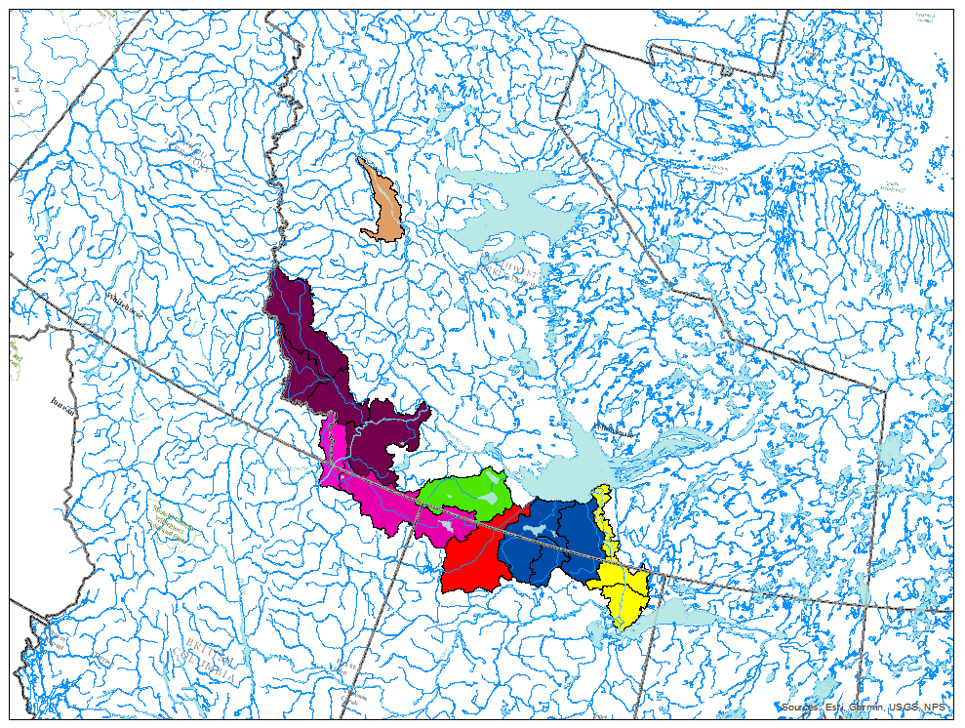
Gathering knowledge
Focus:
Transboundary regions
Areas where human activities could potentially impact groundwater
Areas with great permafrost degradation potential

Slide 15
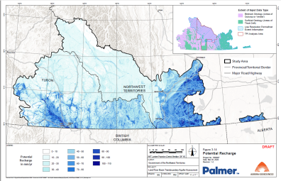
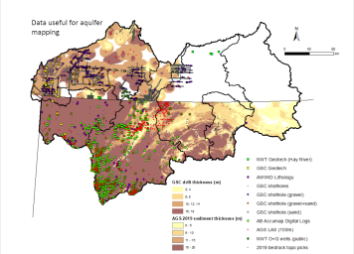
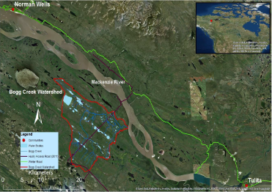

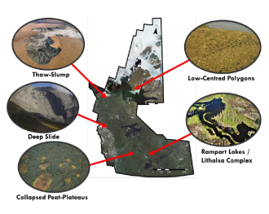
Gathering knowledge
Aquifers assessments projects
Liard River Basin (Transboundary with BC and Yukon)
Hay and Slave Rivers Basins (Transboundary with Alberta)
Baseline assessment projects
Characterization and baseline assessment in advance of shale oil and gas development in the Sahtu
Liard Basin Baseline Groundwater Study
Permafrost assessment projects
Permafrost characterization of the Hay and Slave Rivers Basins
Northwest Territory Thermokarst Collective Mapping Project – Aufeis mapping
Notes:
Aquifer Assessment Projects:
(- Liard project already mentioned above)
- Hay and Slave River Basins:
- Data compilation is done
- A second phase in collaboration with AGS will include:
1. Aquifer mapping of the Hay River Basin
2. Data acquisition (ground truthing, geophysicial surveys) for the other basins
Baseline Assessment Projects
- Regional hydrologic and ecologic characterization and baseline assessment of remote northern Canadian terrain in advance of shale oil and gas development
- Main objectives:
1. Baseline monitoring (groundwater monitoring through wells and permanent springs (aufeis))
2. To assess the role of groundwater flow conditions within the discontinuous permafrost environment
(- Liard Basin Baseline Groundwater Study already mentioned above)
Permafrost assessment projects
- Northwest Territory Thermokarst Collective Mapping Project – Aufeis mapping
- A collaborative to generate empirically-based thermokarst and permafrost feature inventory maps.
- Icing features are part of the project, and the map output will be used for the idetification of groudnwater springs and baseflow

Slide 16
Thank you!
Isabelle_de-grandpre@gov.nt.ca

Slide 17


Groundwater Initiatives and Research in British Columbia
BC Ministry of Environment and Climate Change Strategy
Amy Sloma
June 3, 2020

Slide 18

Province of BC Groundwater Science
ENV
A & W Science / Environmental Monitoring
FLNRORD
Regions
Collaborate on :
Groundwater Characterization Studies
Science & Research
Policy Development
Monitoring
Notes:
Other agencies such as AGRI, EMPR and OGC also complete groundwater science research focussing on areas that are related to their service sector – i.e. OGC does gw science work in the NE with the O&G development

Slide 19

Province of BC Expertise
Specialized knowledge in:
More than 20 staff specialize in & have education & experience in hydrogeology.
Management & Planning
Groundwater Characterization
Groundwater Modelling
Standards and Data Systems
Monitoring Networks
Conducting Regional Studies
Stakeholder Relationships
Protection
Legislation & Policy
Notes:
BC has a population over 5 million people and there are over 1 million users of groundwater in BC. Many of our staff oversee the operational needs of implementing the WSA and GroundWater Protection Reg. Some of the longer term projects (such as mapping or modelling) require more focussed, specialized knowledge and that’s where we utilize the $350,000 of operational funds for specific projects. The internal staff would be the project leads and responsible for the overall delivery of the project.

Slide 20
Our Approach:
Data Systems & Analysis
GWELLS
Mapping
Water Budgets
Modelling & Characterization Projects
Notes:
All of our data systems and analyses have various workload pressures. How we manage these pressures often relies on partnerships with various organizations. We rely on staff and private contractors for data management purposes in our GWELLS application. We also have contracts typically with consultants for new or updating our aquifer mapping. The last two categories - water budgets as well as modelling & characterization projects are a hybrid of internal, consultants and academia.

Slide 21
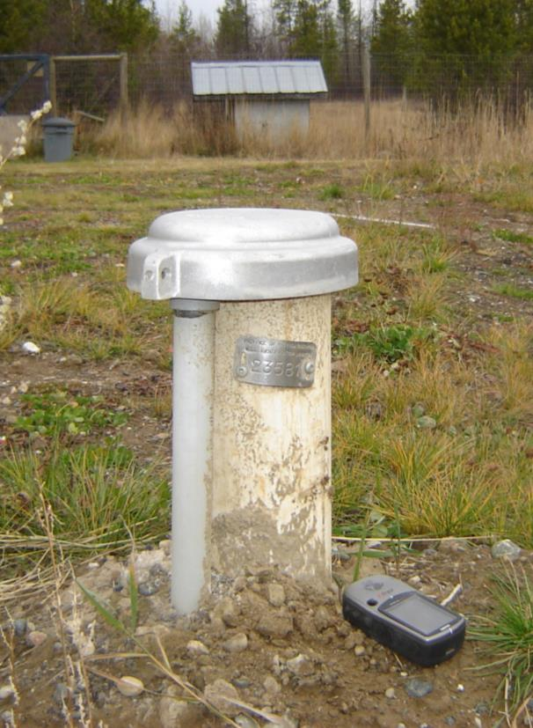
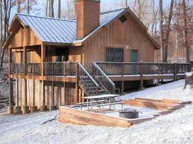
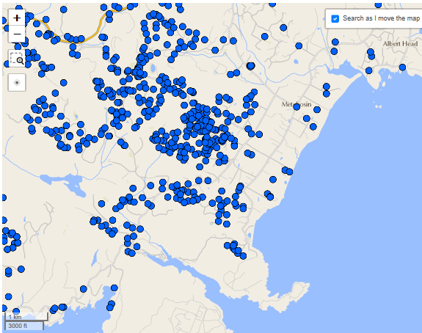

WSA GWPR: Wells
Groundwater Protection Regulation
Addresses hazards at the site scale
Does not address aquifer scale issues
Well log submission required in 2016
Data quality is variable
Abandoned wells may be shown as active
GWELLS database online
Notes:
Information in well reports is entered into the provincial GWELLS database and used by drillers, hydrogeologists, government staff etc. to inform work related to groundwater (e.g., aquifer mapping, aquifer vulnerability studies, technical assessments for gw licensing, assessing risk of artesian conditions prior to drilling, etc.)

Slide 22
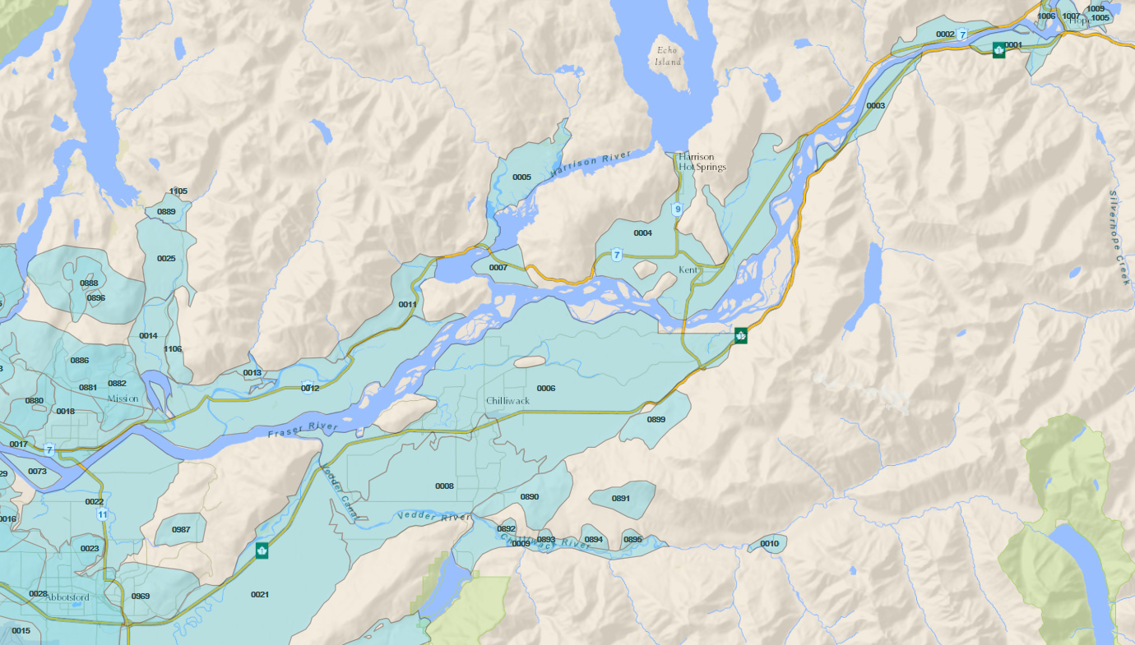

BC Aquifer Mapping Prioritization
Emerging Issues & Local Knowledge
Support for the WSA (e.g. water licensing)
Available Information (Registered Water Wells)
Notes:
New aquifer mapping studies are prioritized based on a number of factors, but may be considered based on:
the locations of unmapped registered water wells in the GWELLS database,
the local knowledge of emerging issues that our FLNR regional offices have through their work within communities such as in supporting water licensing decisions, and
the locations of major resource development projects (e.g. mines, oil and gas).
The needs for mapping of aquifers and inclusion into the BC database, or for other aquifer characterization studies, will change as communities expand or new resources are developed.

Slide 23
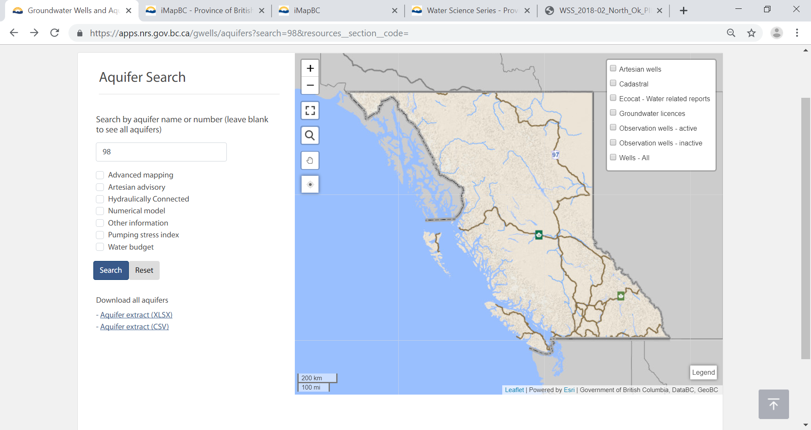
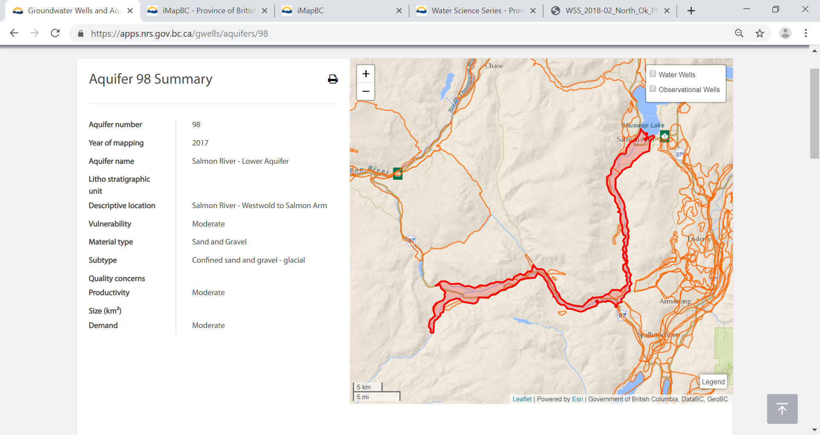
Accessing Aquifer Mapping
https://apps.nrs.gov.bc.ca/gwells/aquifers
Notes:
The new GWELLS application is an upgrade of the former WELLS database.
The new application can be still be used to search information about Wells & mapped aquifers…
All mapped aquifers have a factsheet attached that describes the characteristics of the aquifer (well yields, well depths), some are 2-pagers with Piper plots and observation well trends.

Slide 24

BC Aquifer Mapping Limitations
Testing
Analysis & Models
Understanding Aquifers
Monitoring
Mapping
Mapping is just one piece of the puzzle
BC Water Science Series

Slide 25
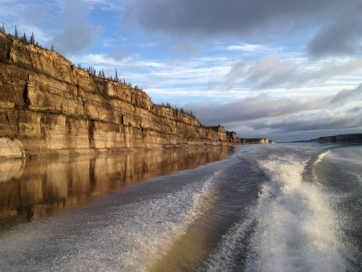
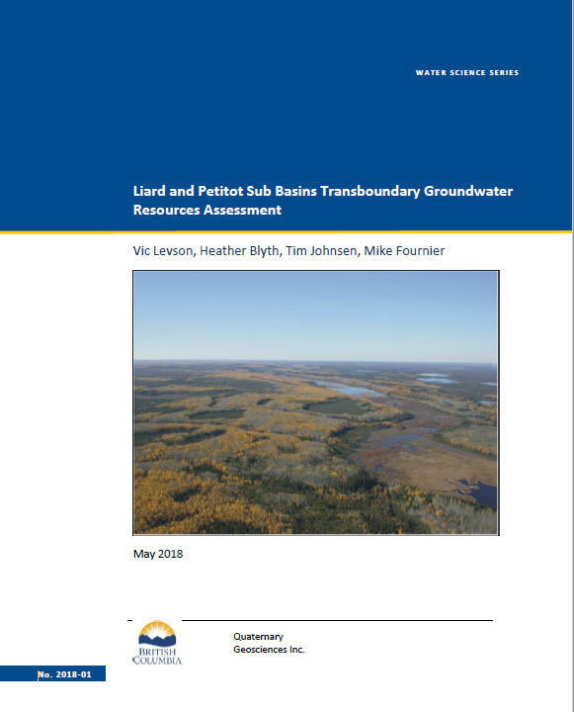

Key Reports:
Liard and Petitot Sub Basins Transboundary Groundwater Resources Assessment (2018)
Provides geological and hydrogeological data to aid in groundwater resources assessments in the Liard and Petitot sub-basins transboundary water management areas
Compiles, synthesizes and analyzes groundwater information , including:
Surficial geology maps, water well records, geology, hydrology, current development and groundwater use
Notes:
We’ve been furthering the recommendations in the bilateral learning plan by completing drilling in two of the high priority aquifers identified in this study. These wells were completed in 2019 in partnership with the Fort Nelson First Nation and are being incorporated into our Provincial Observation Well Network (217 wells)

Slide 26

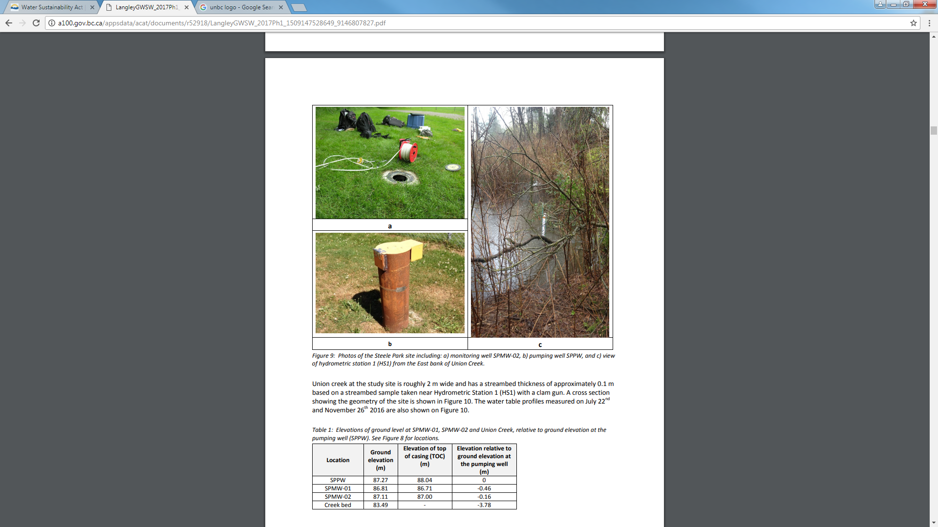
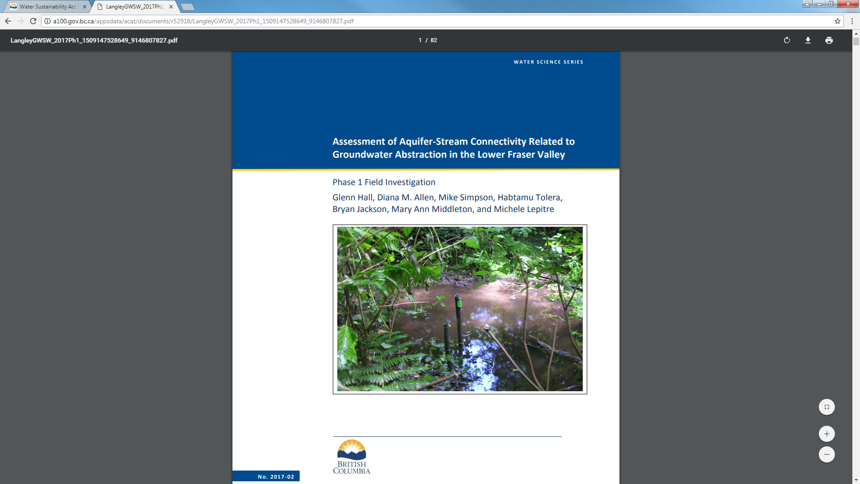
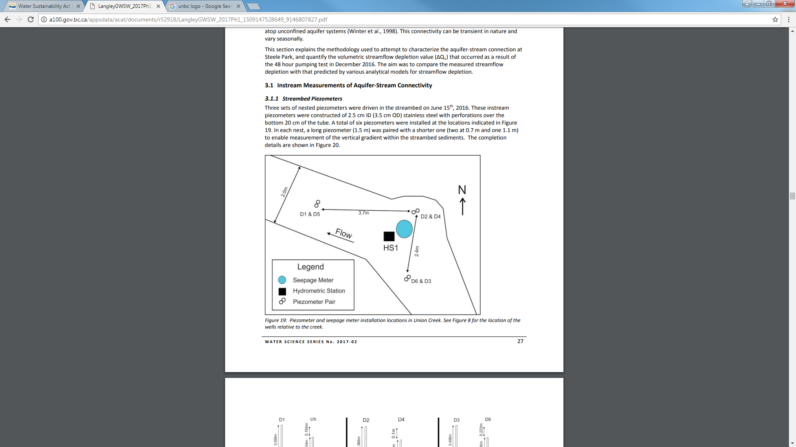
Example:
Our Approach:
Research Partnerships
Notes:
The study consisted of two parts: (1) a targeted Phase 1 field investigation in Langley, BC aimed at determining the impacts of pumping on aquifer-stream interactions, and (2) a multi-level regional stream vulnerability assessment in the Lower Fraser Valley for determining the vulnerability of other similar types of stream-aquifer systems in order to identify streams that might be similarly impacted by groundwater abstraction.

Slide 27
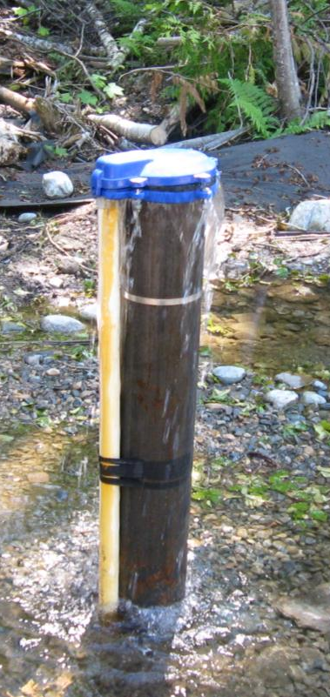
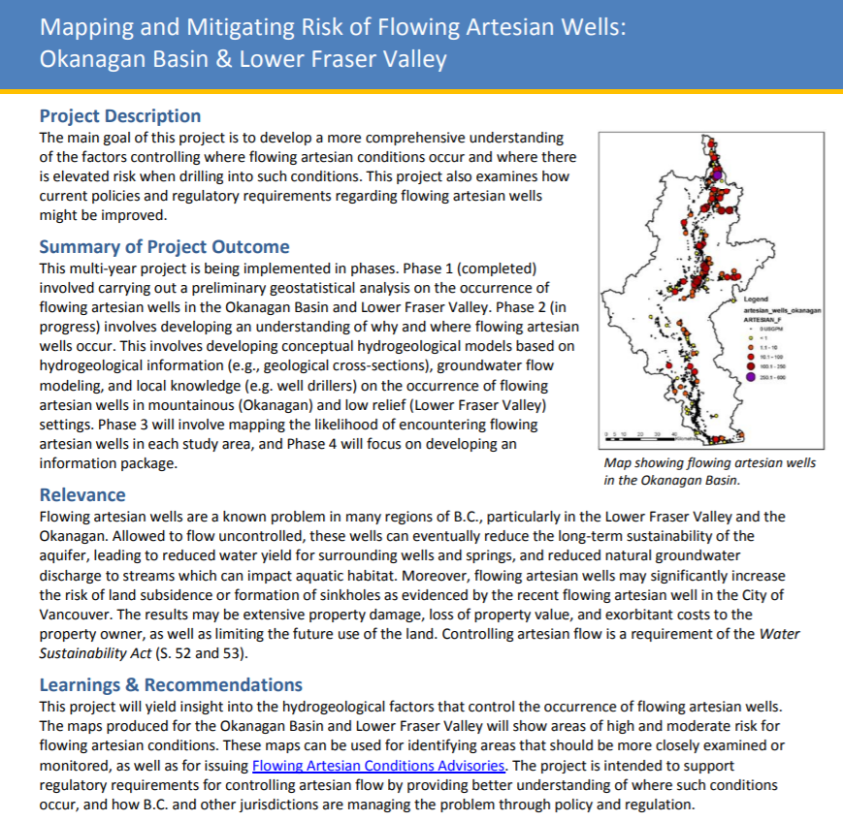
Our Approach: Compendium
WSS 2019-08: Compendium of Provincial Groundwater Science and Monitoring Projects: 2018-19
Notes:
As well, all projects that are completed or in-progress will have a one page summary write-up as part of our annual compendium. Please send me an email if you would like to be advised annually when this compendium is up on our webpage.

Slide 28

Questions, suggestions, advice?
Thank you!
Amy Sloma
amy.sloma@gov.bc.ca

Slide 29
Yukon Government’s Groundwater Program
June 3, 2020 · National Dialogue on Groundwater · Brendan Mulligan

Slide 30
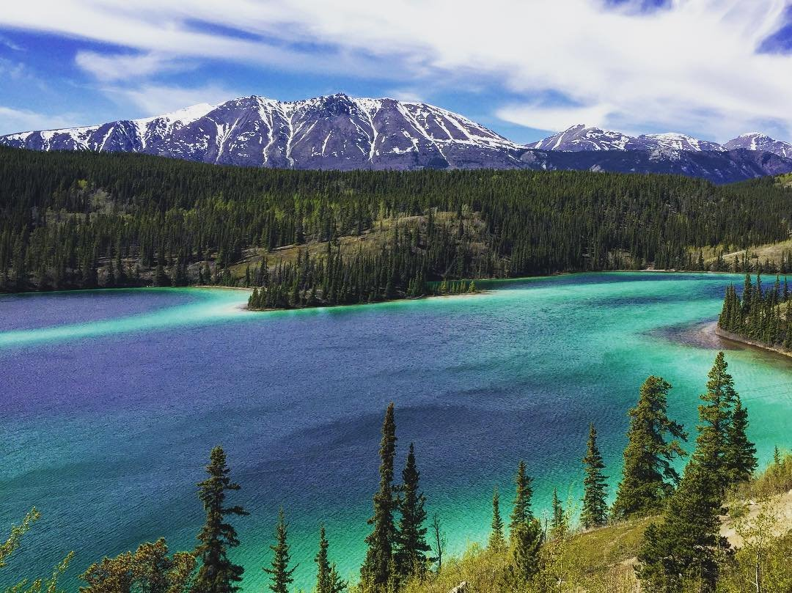
482,443 km²
Cold, changing climate
40,854 people
97% dependent on groundwater
Young, evolving groundwater program…

Slide 31
Yukon Government’s Groundwater Program
Collaboration & Accessibility
Understanding & Monitoring
Management & Protection
Education & Awareness
Classroom presentations and community outreach
Guidance
Regulation
Technical reviews
Yukon Observation Well Network
Aquifer mapping
Targeted projects
Workshop on Hydrogeology in Yukon
Yukon Water Well Registry
Yukon Water Data Catalogue
Groundwater Interdepartmental Working Group
Multi-jurisdictional coordination

Slide 32
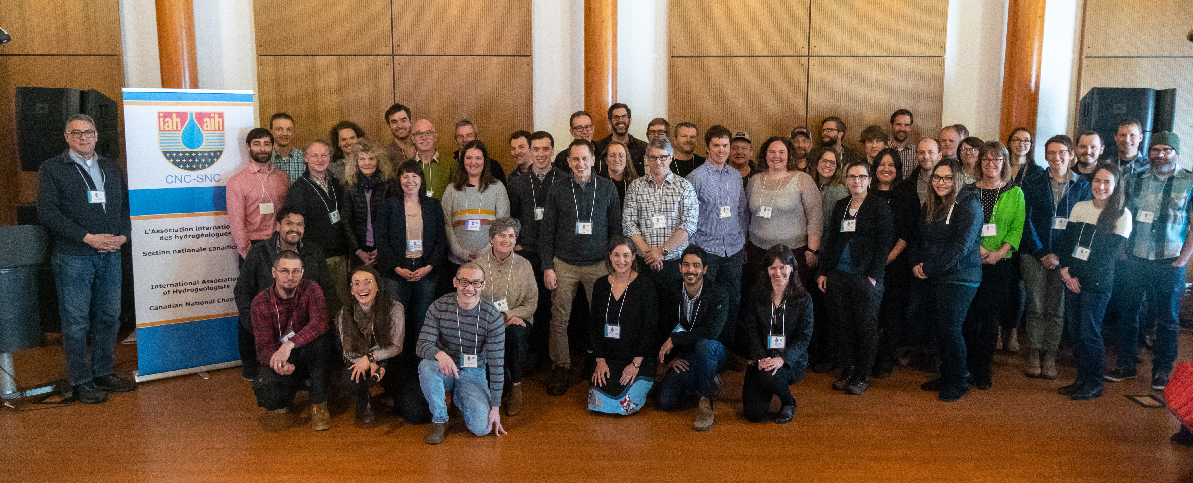


Workshop on Hydrogeology in Yukon
Collaboration & Accessibility
Understanding & Monitoring
Management & Protection
Education & Awareness
Classroom presentations and community outreach
Guidance
Regulation
Technical reviews
Yukon Observation Well Network
Aquifer mapping
Targeted projects
Workshop on Hydrogeology in Yukon
Yukon Water Well Registry
Yukon Water Data Catalogue
Groundwater Interdepartmental Working Group
Multi-jurisdictional coordination
CNC - SNC

Slide 33
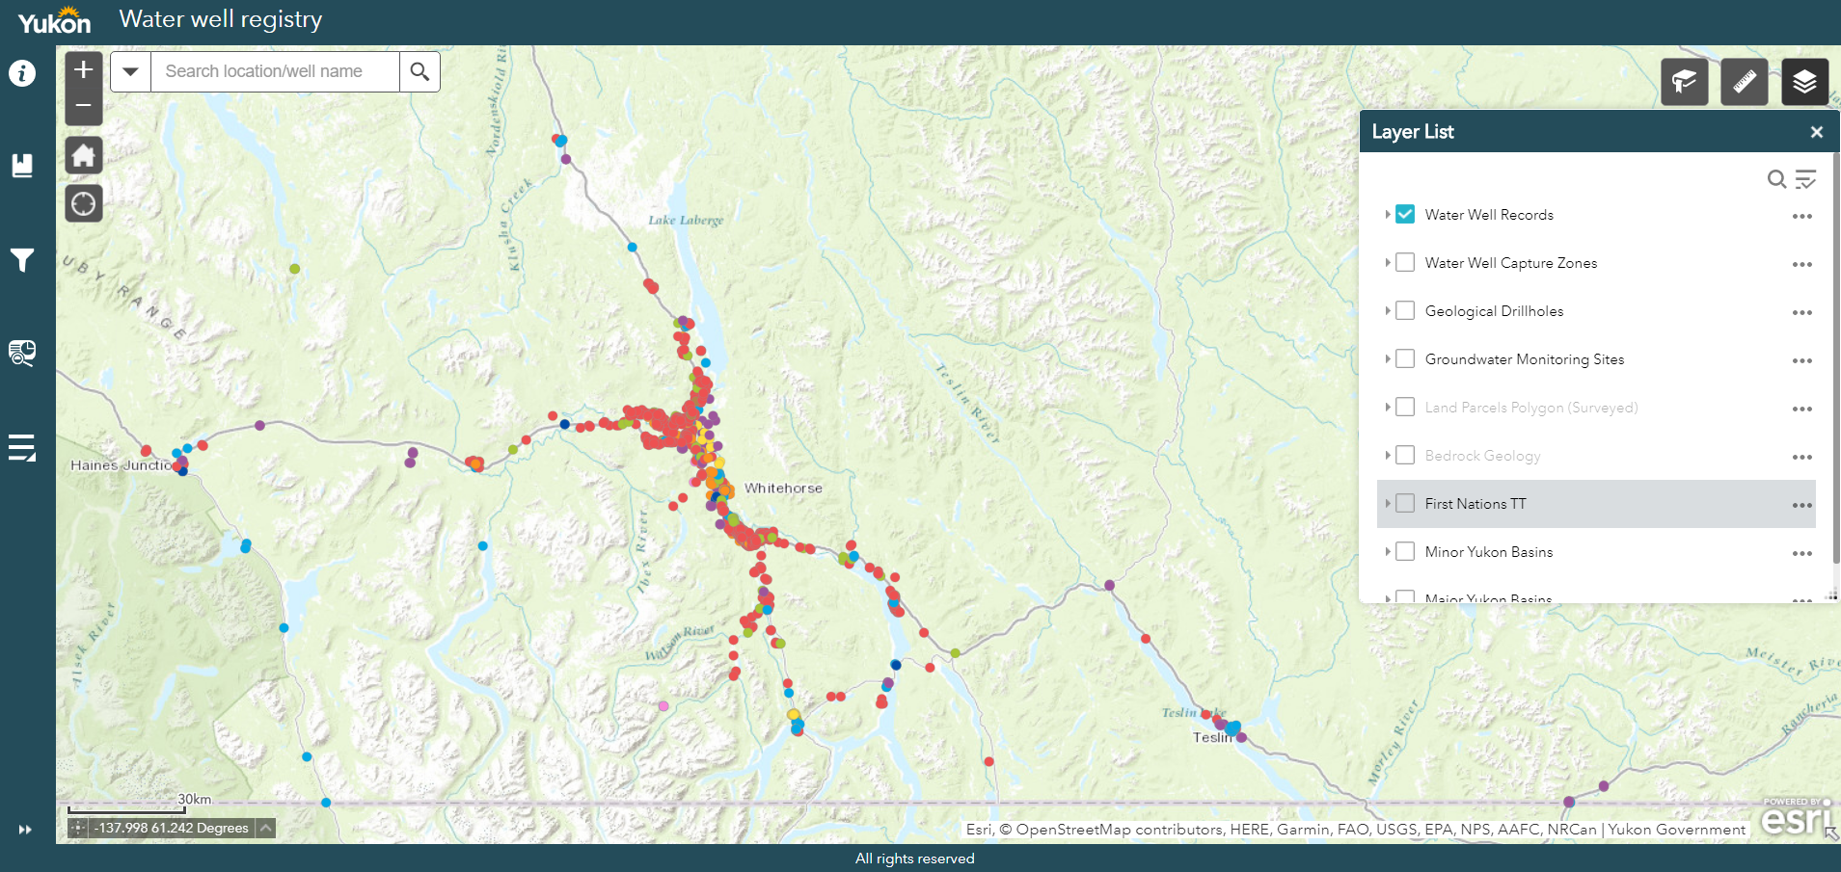
Collaboration & Accessibility
Understanding & Monitoring
Management & Protection
Education & Awareness
Classroom presentations and community outreach
Guidance
Regulation
Technical reviews
Yukon Observation Well Network
Aquifer mapping
Targeted projects
Workshop on Hydrogeology in Yukon
Yukon Water Well Registry
Yukon Water Data Catalogue
Groundwater Interdepartmental Working Group
Multi-jurisdictional coordination
https://yukon.ca/groundwater

Slide 34

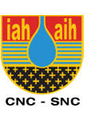
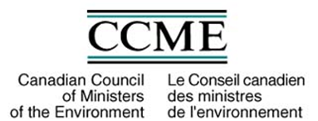
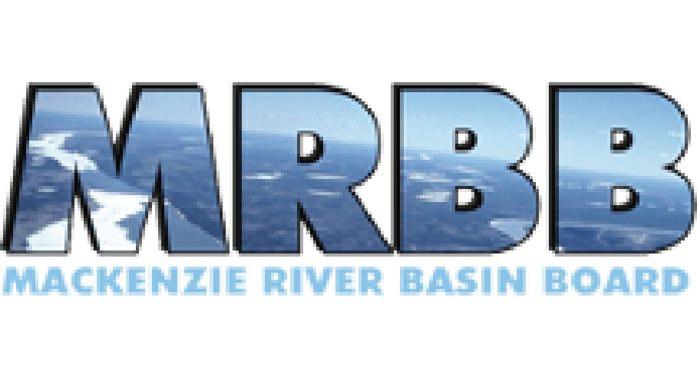
Collaboration & Accessibility
Understanding & Monitoring
Management & Protection
Education & Awareness
Classroom presentations and community outreach
Guidance
Regulation
Technical reviews
Yukon Observation Well Network
Aquifer mapping
Targeted projects
Workshop on Hydrogeology in Yukon
Yukon Water Well Registry
Yukon Water Data Catalogue
Groundwater Interdepartmental Working Group
Multi-jurisdictional coordination

Slide 35
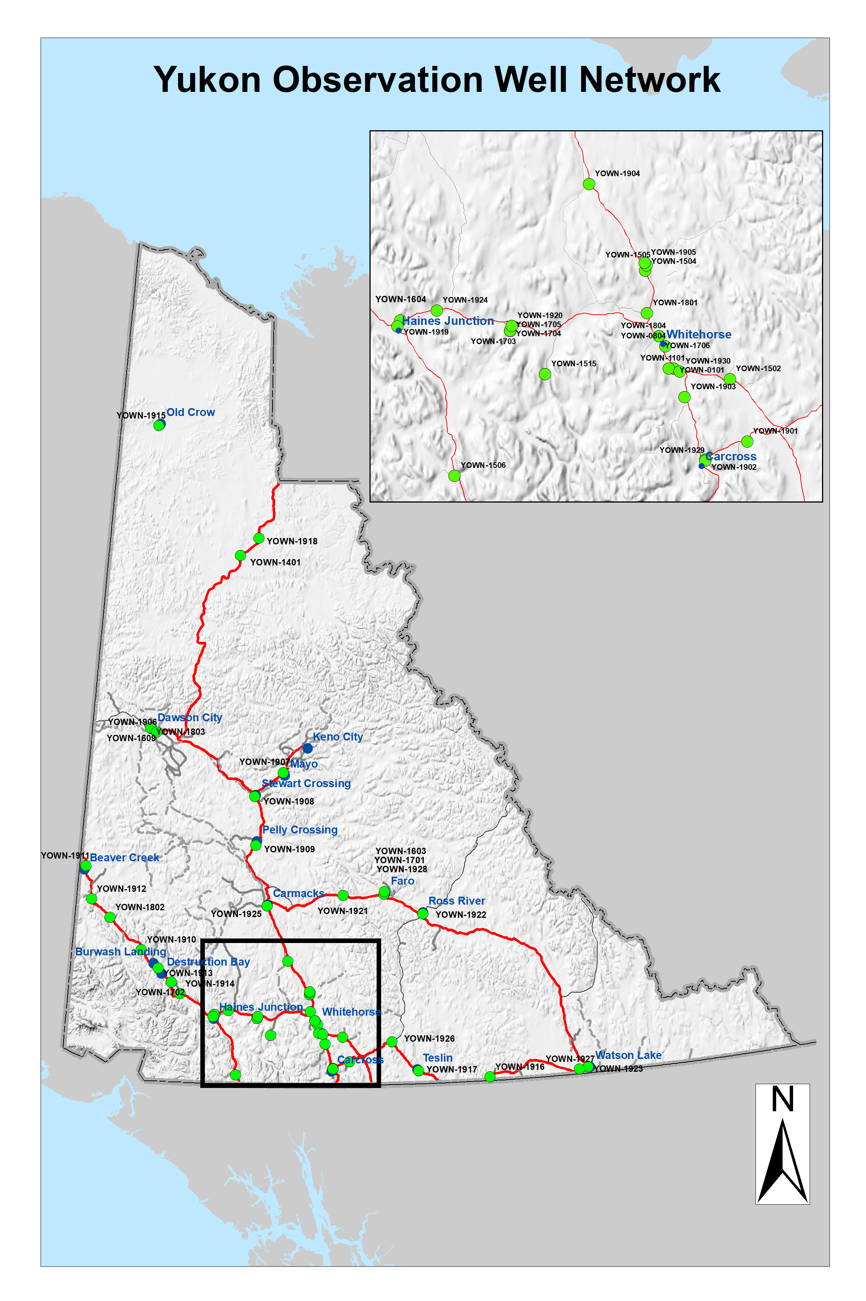
YOWN
Collaboration & Accessibility
Understanding & Monitoring
Management & Protection
Education & Awareness
Classroom presentations and community outreach
Guidance
Regulation
Technical reviews
Yukon Observation Well Network
Aquifer mapping
Targeted projects
Workshop on Hydrogeology in Yukon
Yukon Water Well Registry
Yukon Water Data Catalogue
Groundwater Interdepartmental Working Group
Multi-jurisdictional coordination
Water quality / level
8 wells in 2013, 52 wells currently
Modest budget to add new wells annually
Data interpretation (2020)

Slide 36
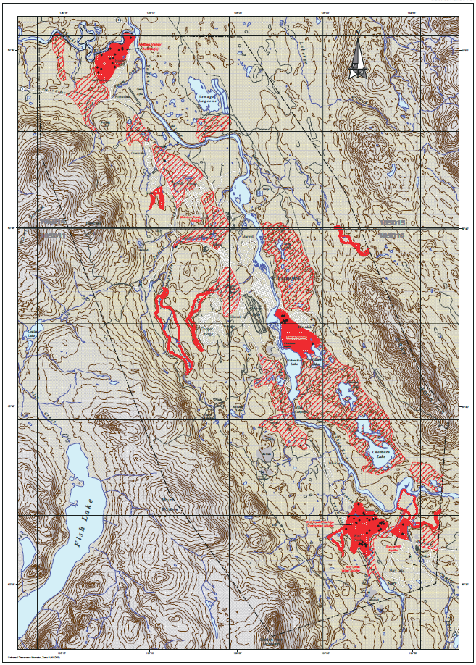
Aquifer Mapping
Collaboration & Accessibility
Understanding & Monitoring
Management & Protection
Education & Awareness
Classroom presentations and community outreach
Guidance
Regulation
Technical reviews
Yukon Observation Well Network
Aquifer mapping
Targeted projects
Workshop on Hydrogeology in Yukon
Yukon Water Well Registry
Yukon Water Data Catalogue
Groundwater Interdepartmental Working Group
Multi-jurisdictional coordination
Developed aquifers underlying communities across the territory
3-year initiative to map 3 communities with greatest number of available well records:
2020-21: Carmacks
2021-22: Watson Lake
2022-23: Whitehorse
Map 7 – Overburden Aquifer Potential. From the Preliminary Groundwater Inventory of the City of Whitehorse, prepared by Community Development Branch by Gartner Lee Ltd., 2003.

Slide 37
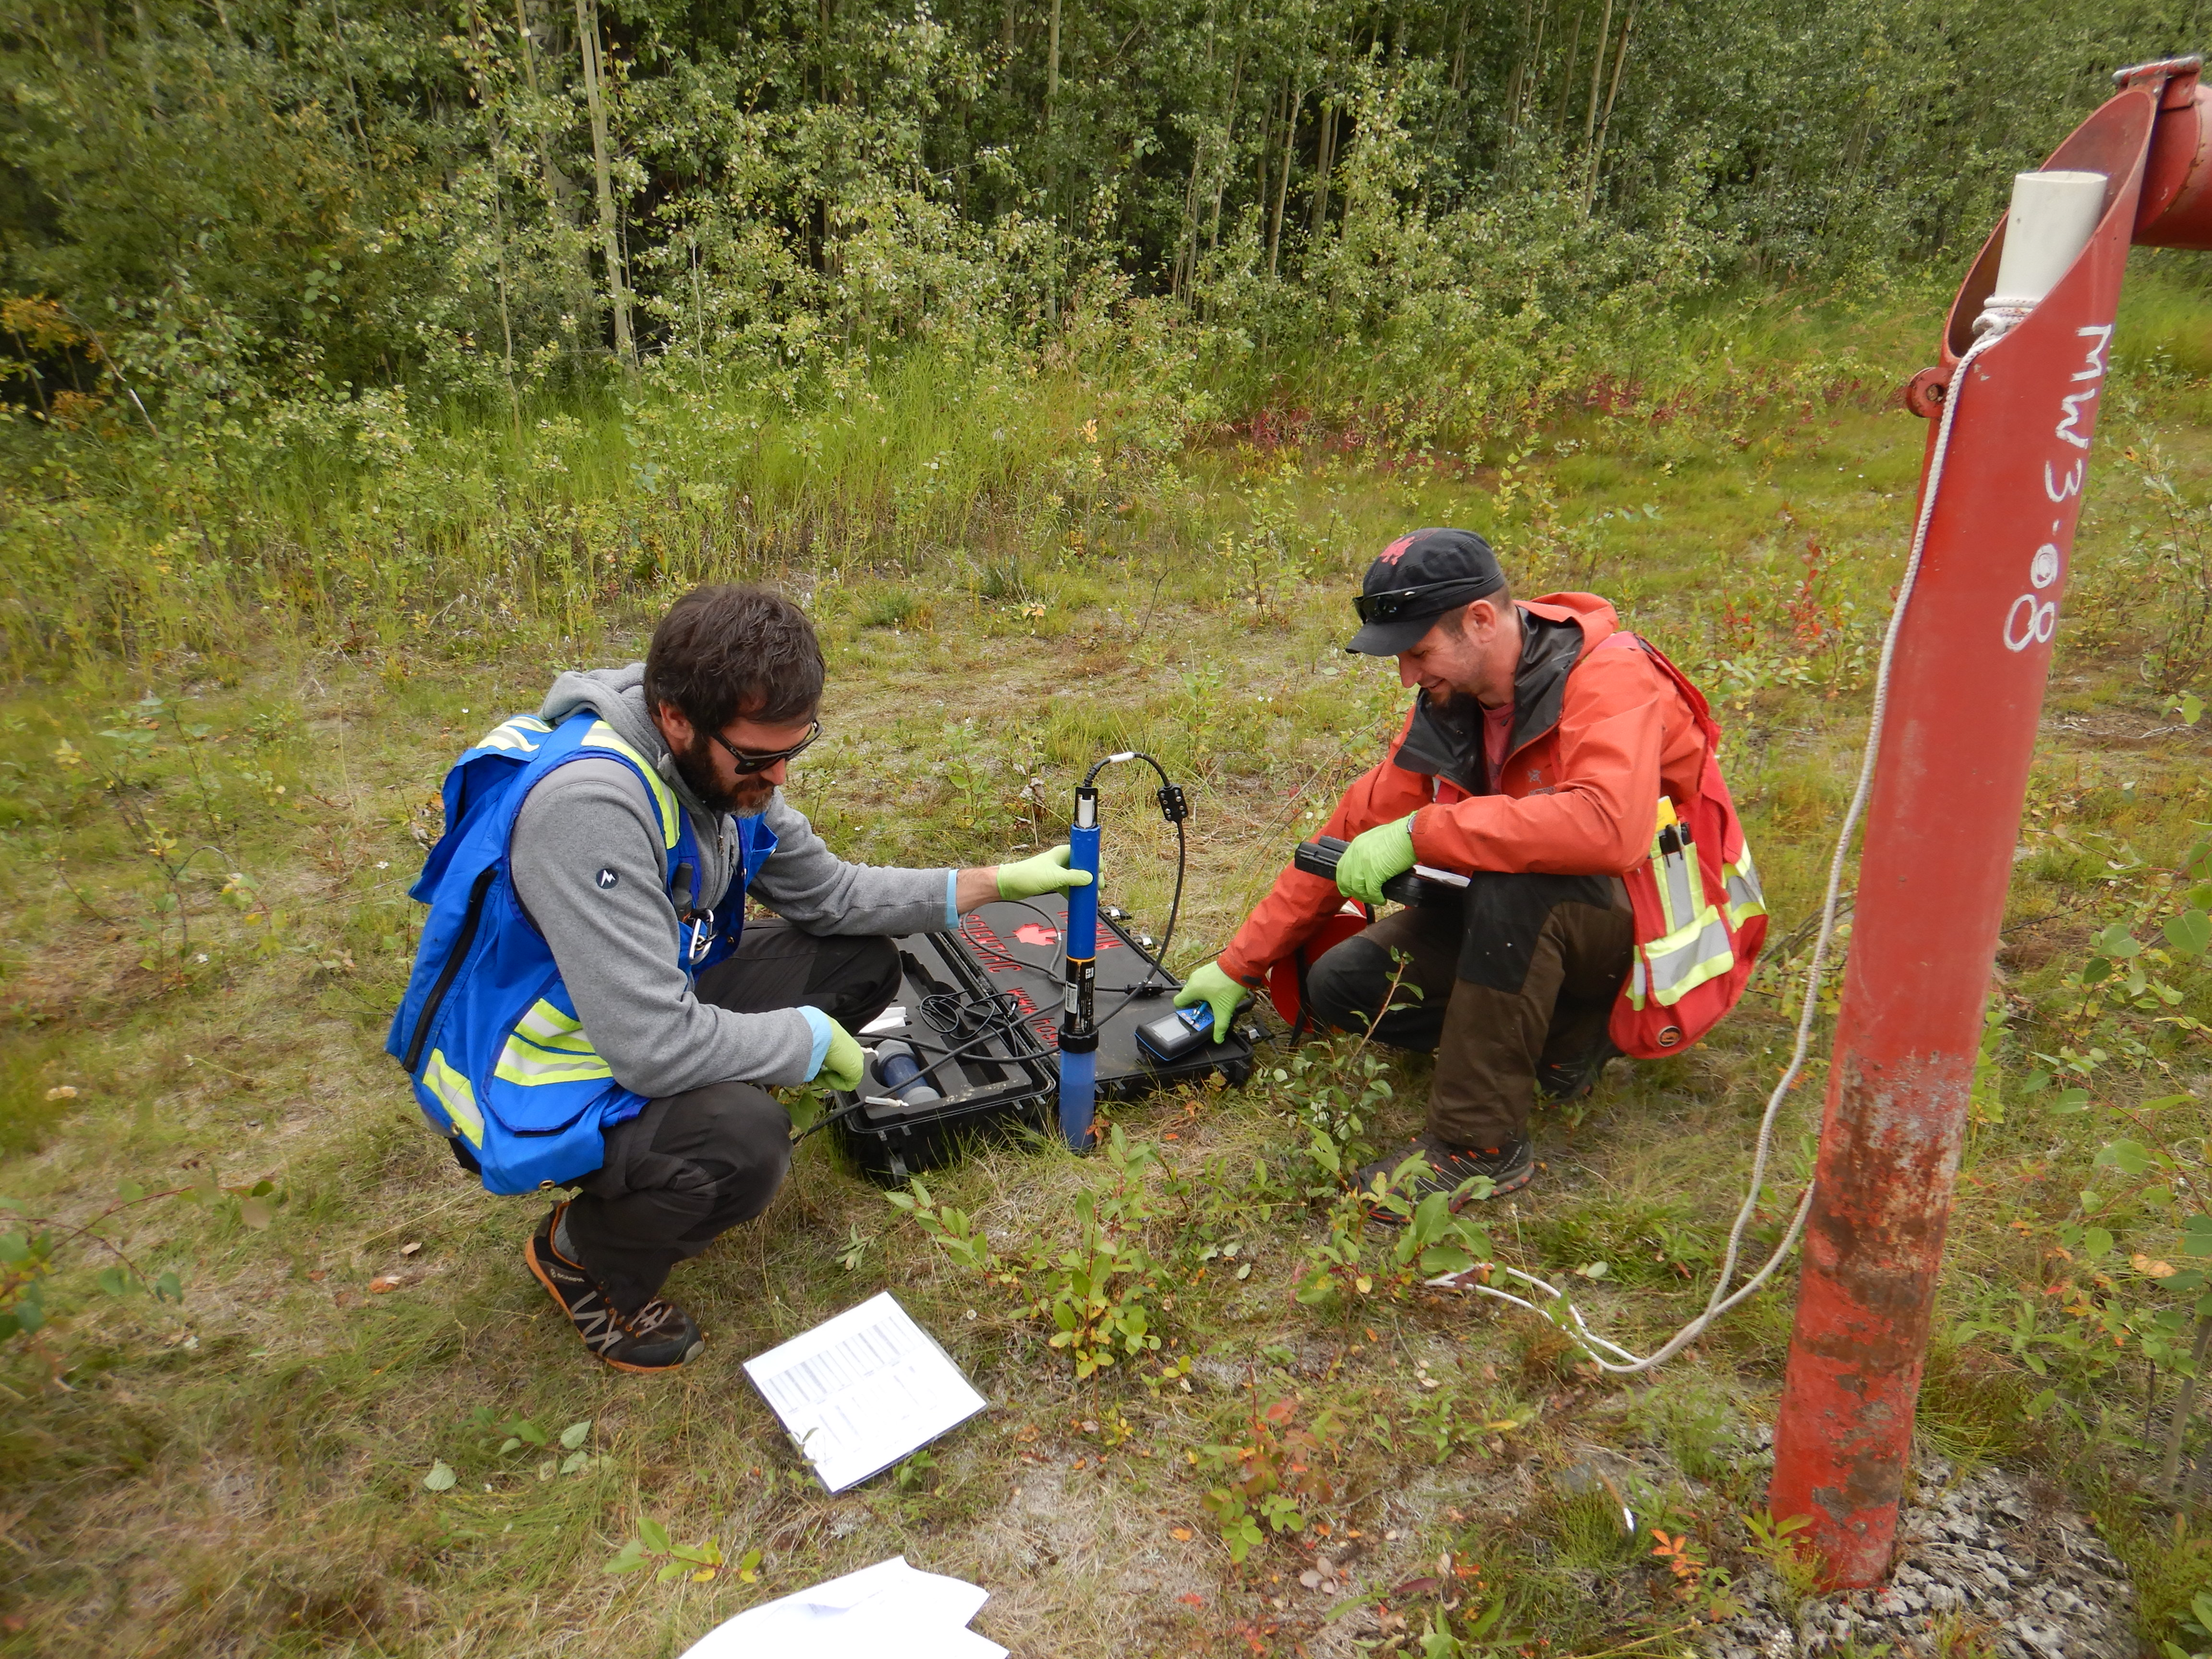
Collaboration & Accessibility
Understanding & Monitoring
Management & Protection
Education & Awareness
Classroom presentations and community outreach
Guidance
Regulation
Technical reviews
Yukon Observation Well Network
Aquifer mapping
Targeted projects
Workshop on Hydrogeology in Yukon
Yukon Water Well Registry
Yukon Water Data Catalogue
Groundwater Interdepartmental Working Group
Multi-jurisdictional coordination
Reviewing projects in various stages of assessment and licencing
Hard rock mines
Municipal wastewater treatment facilities
Conducting site visits and studies

Slide 38
Questions?
Brendan Mulligan · Brendan.Mulligan@gov.yk.ca

Slide 39
Last points on the agenda
Open discussion from all based on the comments received from participants – 25 minutes
Impacts of COVID-19 on all jurisdiction activities (e.g. Fieldwork)
Canada Water Agency - What is the place for groundwater?
New version of the National Hydro Network (NHN)
Data base contacts in provinces and territories – please follow up with Étienne Girard
Terms of Reference for the NDGW
Next meeting
September 2 - Presentations by Martin Stapinsky from the Ministère de l’environnement et de la lutte aux changements climatiques de la province de Québec and Daniel Paradis from the Geological Survey of Canada in Quebec City.

Slide 40
THANK YOU
/
MERCI!

